Slide 1
Osher Lifelong Learning Institute, Summer 2026
Contemporary Economic Policy
University of Hawaii, Manoa
Host: Geoffrey Woglom, Director
National Economic Education Delegation

Slide 2
Course Schedule
Contemporary Economic Policy
  Week 1 (7/2): Saving Social Security, Geoffrey Woglom, Amherst College
  Week 2 (7/9): Trade & Globalization, Luisa R. Blanco, Pepperdine University
  Week 3 (7/16): Crypto Currencies and the Future of Money, Geoffrey Woglom
  Week 4 (7/23): Economics of Immigration, Luisa R. Blanco, Pepperdine University
  Week 5 (7/30): Federal Debt and Deficits, Robert Rebelein, Vassar College
  Week 6 (8/6): Climate Change Economics, Gary Yohe, Wesleyan University

Slide 3
Submitting Questions
Submit questions in the chat. I will try to address questions after 10-minute intervals. We will also do a verbal Q&A once the material has been presented.
Slides will be available from the NEED website: https://needecon.org/delivered_presentations.php.

Slide 4
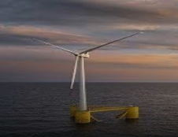
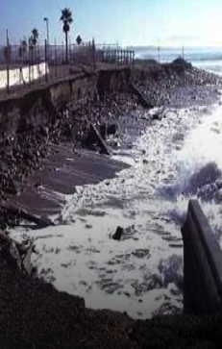
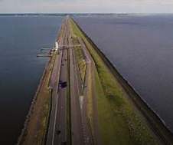
National Economic Education Delegation
Climate Change Economics
Part 2
Gary W. Yohe, PhD LLC
Wesleyan University

Slide 5


Outline
A working definition of risk
Risks posed by climate change
Climate example: sea level rise
Responding to climate risk
Insurance
The science of characterizing risk

Slide 6
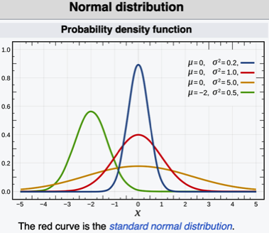
A working definition of risk Source: https://www.ipcc.ch/report/ar4/syr/
Risk imposed by any particular
event is the product of the
likelihood that it will occur and
its consequences.
As a mathematical concept, it
is the weighted average of those
products.
Notes:
This is the standard definition that was accepted by the IPCC in the Synthesis Report of its Fourth Assessment Report (AR4 SYN). Source: https://www.ipcc.ch/report/ar4/syr/
Let the distribution of the likelihood and consequences of a climate impact be {LIK_{j}; CON_{j}} for n data pairs. The mathematical estimate of risk as an expected value is then Risk = Σ[{LIK_{j} × CON_{j}}

Slide 7
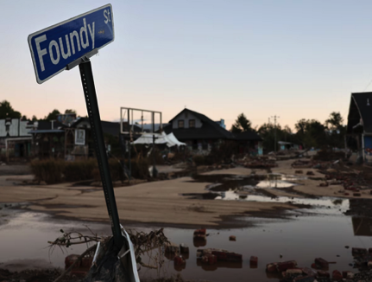
Risk as a framing concept
As a framework for approaching
climate change impacts, the
components of risk can organize
rigorous thinking about climate
consequences.
Together, they make it clear that
low likelihood climate change
impacts with large consequences
can be labeled “high risk” or “very
high” risk without being criticized
as “fear mongering”.

Slide 8
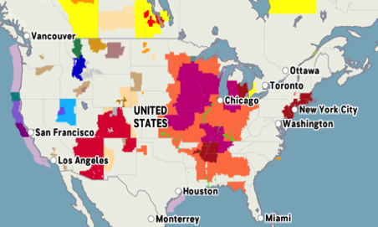
Risks posed by climate change
Civilization faces many risks driven by climate change: (e.g., 06/28/2026)
riverine flash floods,
prolonged droughts,
prolonged periods of extreme
heat or cold,
changing character & strength
of cyclones and hurricanes,
red flag alerts for wildfires,
changes in the variation of
cycles,
and the like…

Slide 9
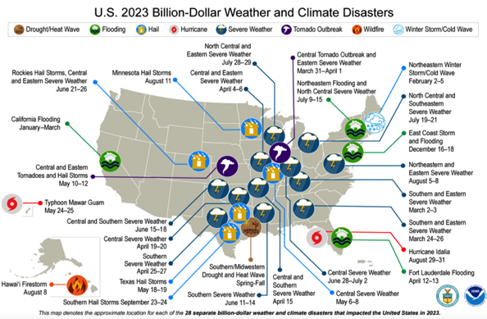
Examples of extreme damage - 2023

Slide 10
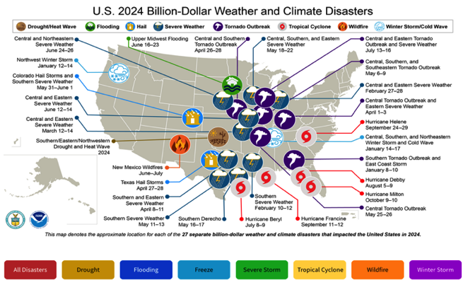
More examples of catastrophic loss - 2024

Slide 11
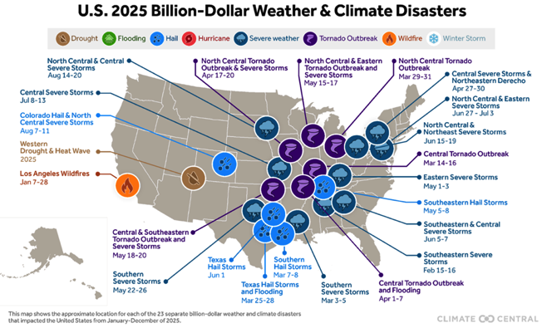
The most recent yearly report of extreme damage - 2025

Slide 12
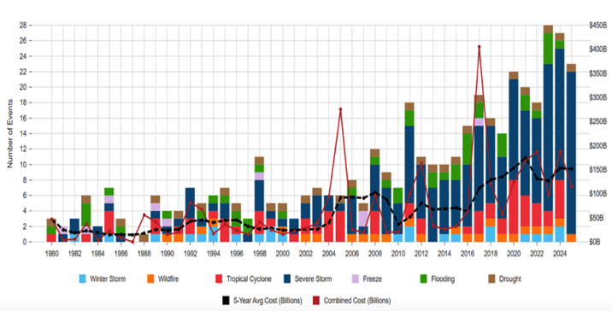
Billion dollar events – a time series from 1980

Slide 13
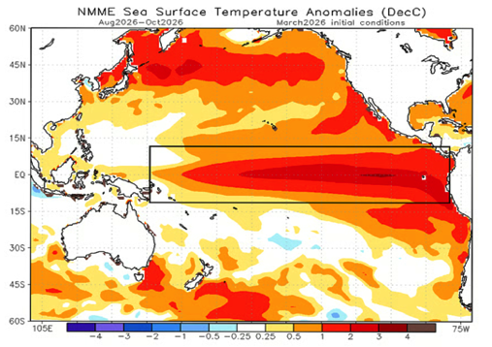
Record (“very strong”) El Nino on the way in 2026
{Source: https://www.downtoearth.org.in/climate-change/a-rare-super-el-ni%C3%B1o-may-be-forming-in-the-pacific-and-it-could-reshape-global-weather-starting-this-summer}

Slide 14
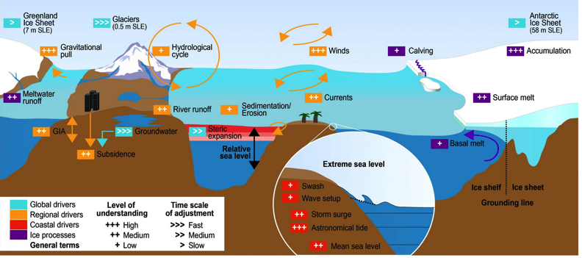
A risk example – sea level rise (SLR)
Source: Figure 4.5 in https://www.ipcc.ch/srocc/chapter/chapter-4-sea-level-rise-and-implications-for-low-lying-islands-coasts-and-communities/

Slide 15
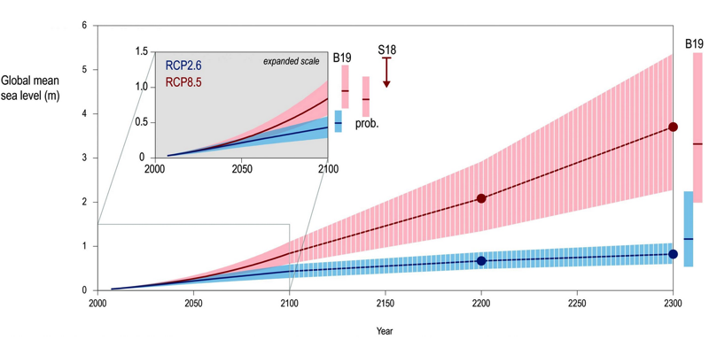
Projections of future SLR
Source: Figure 4.2 in https://www.ipcc.ch/srocc/chapter/chapter-4-sea-level-rise-and-implications-for-low-lying-islands-coasts-and-communities/
Notes:
The projections are driven by two Representative Concentration Pathways (RCPs) designed by the IPCC to characterize emissions along alternative global pathways of macro-scale socio-economic development.

Slide 16
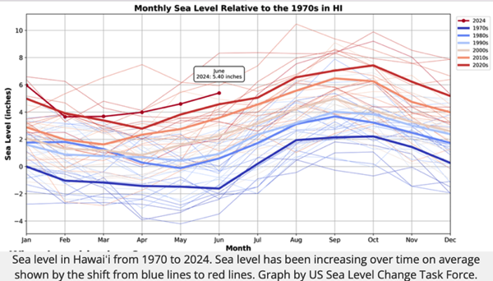
Historical monthly seal level rise for Hawaii with decadal averages (Source: https://climate.hawaii.gov/hi-facts/sea-level-rise/)

Slide 17
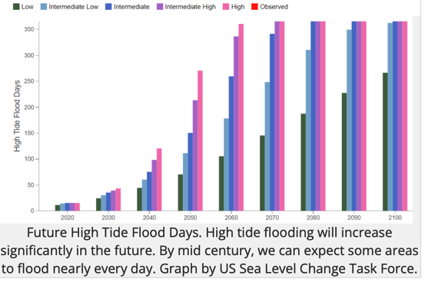
Associated number of days Hawaii can expect high tides from low to high levels (Source: https://climate.hawaii.gov/hi-facts/sea-level-rise/)

Slide 18
The projected consequences of future flooding in HI
28,000 additional acres of unusable land
6,500 additional structures at risk from SLR
550 cultural sites, 38 miles of road and $19⁺ billion in assets exposed to chronic flooding
Waikiki and military infrastructure around Pearl Harbor at risk
→ → existential threats to some parts of food security, water
supply, economy, cultural heritage, and habitability

Slide 19
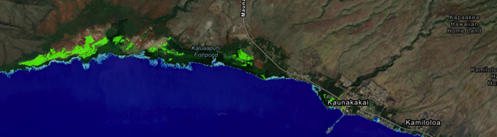
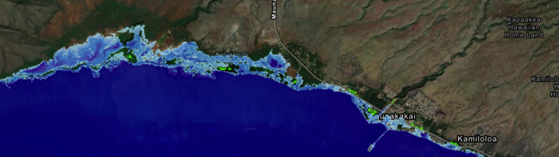
SLR vulnerability along southern Maui (1.5 & 3.0 feet)
Notes:
Source: https://coast.noaa.gov/slr/#/layer/slr/1.5/-17483028.125183936/2405673.5848867544/13.112/satellite/none/0.8/2050/interHigh/noAccretion/NOS_Minor

Slide 20
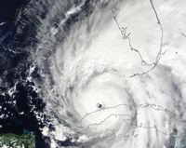
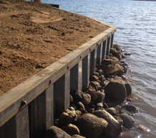
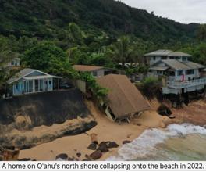
Responding to climate risk
1. Abate: (mitigate): reduce
emissions of greenhouse gases;
2. Adapt: reduce the climate
Impacts’ consequences;
3. Suffer: recognize that no
combination of mitigation
and adaptation will
eliminate climate risk
completely,

Slide 21
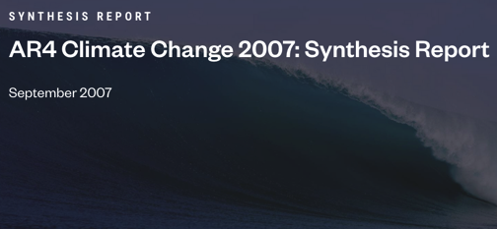
The Intergovernmental Panel on Climate Change
(IPCC) on approaching those three response options
“Responding to climate
change involves an
iterative risk
management process
that includes both
adaptation and
mitigation and takes
into account climate
change damages,
co-benefits, sustainability, equity and attitudes to risk.”
Notes:
Consensus language from the Summary for Policymakers of the Synthesis Report for the Forth Assessment Report (AR4; 2007) changed how the world approached the climate problem.

Slide 22
The meaning of “iterative risk management”
Before 2007, the mitigation question was approached as an enormous intertemporal welfare maximizing problem fraught with enormous uncertainty and very long time horizons.
After 2007, the problem was framed in terms of minimizing cost of responses designed to maintain risk at a tolerable level:
Cost minimization included taking advantage of the ability
to make mid-course corrections (that is to say, “iterate”).
Notes:
A effective mitigation strategy would transparently and predictably include timely iterations - ”mid-course corrections” based on new climate science, observed efficacies of taken actions with regard to costs, co-benefits, equity implications, sustainability in a changing geopolitical environment, and public attitudes toward risk in general and extreme events in particular.

Slide 23
Taking advantage of the two components of risk
Mitigation can slow warming and thereby reduce the likelihood of an extreme event at any point in time.
Adaptation can reduce the consequences associated with that event.
Both can work together as complements to reduce, but not eliminate, residual damages.
Just because you invest more in one action does not mean that it would be effective to invest less in the other because:
Mitigation produces long-term likelihood benefits while
adaptation can produce more immediate and
targeted benefits in the short run.

Slide 24
The popular insurance analogy
Property and casualty insurance allows policyholders to lower premiums by accepting deductible provisions while still having coverage for larger damages (up to limits included in the policies).
Investing in mitigation and adaption has been likened to buying this type of insurance, but
this misses their inability to cover residual damages
from the unavoidable suffering choice that are
usually the most severe outcomes even if
they are unknowingly unlikely.

Slide 25
Crisis in the insurance industry from climate risk
In California: State Farm and Allstate have stopped selling property insurance to new customers.
In Florida: Farmers Insurance has announced it will no longer offer any new property coverage; AIG will no longer insure houses along the Florida coastline.
In Louisiana: The providers of policies for one-fifth of homeowners have canceled coverage.
In Texas: Many small insurance companies have become insolvent.
Source (from 2024): https://www.eli.org/sites/default/files/files-general/2024-03-13%20Coastal%20Property%20Insurance%20Read%20Ahead%20Document.pd

Slide 26
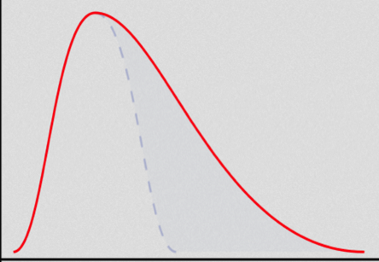
Risk management and accounting for the extremes
When data are sufficient, robust
statistical analysis can tell
iterative managers to worry more
about the upper regions of
damage possible impacts.
New science can then suggest
how those extremes may be
more likely than previously
thought.
Here, the dashed blue probability
curve moves to the right to depict
the effect of accepting the new
science.
P
r
o
b
a
b
i
l
i
t
y
Damages calibrated in currency, lives, etc…

Slide 27
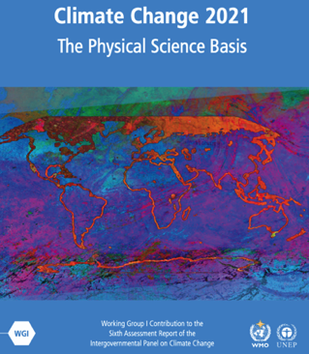
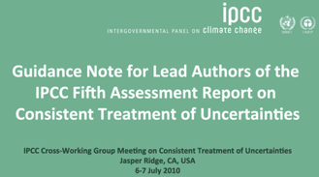
What if the data do not support statistical analysis?

Slide 28
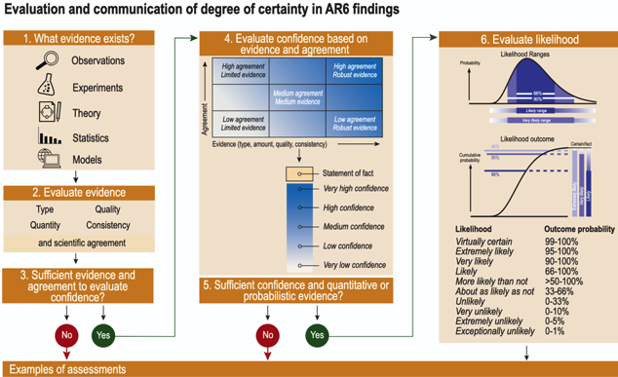
Comparing of likelihood and confidence

Slide 29
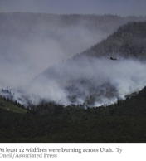
CLOSING REMARKS (beyond ”it all depends on something”)
Risk management is the state of the art – the product of the likelihood of an event and its consequences
Climate impacts drive climate consequences wherein damages (and occasionally benefits) are produced
Mitigation can reduce likelihoods by delaying impacts
Adaptation can reduce consequences by reducing vulnerabilities of exposure, but it can be overwhelmed during extremes events
Mitigation and adaptation cannot completely eliminate risk leaving residual consequences that can be very large

Slide 30
Thank you!
Gary Yohe, LLC
gyohe@Wesleyan.edu
climatecafe.substack.com
Contact NEED: info@NEEDEcon.org

Slide 31
Time for questions
About the talk
About recent events with regard to confidence about climate change risk findings
About defending science in a hostile world
About the difference between hope v optimism
About scientists’ responsibilities to carry on
About science consumers’ responsibilities in assessing and processing climate science uncertainties and climate change risks

Slide 32
Thank you!
Any Questions?
www.NEEDEcon.org
Gary Yohe
gyohe@wesleyan.edu
Contact NEED: info@NEEDEcon.org
Submit a testimonial: www.NEEDEcon.org/testimonials.php
Become a Friend of NEED: www.NEEDEcon.org/friend.php

Slide 33
Reserve slides
Science success story – slides 34 & 35
Story about RCP8.5 – slide 36
San Francisco SLR response – slides 37-41

Slide 34
An example of a new science success story
M. Kotz, A. Levermann, and L.Wenz) paper published “The economic commitment of climate change” published in Nature by in April of 2024 {https://www.nature.com/articles/s41586-024-07219-0.pdf }. It attracted significant interest in the climate science community and beyond.
As always happens when that happens, other scholars (e.g., T. Bearpark, D. Hogan, S. Hsiang, and C. Schotz) examined it carefully and likely undertook some replication experiments.
They voiced some serious concerns about the methods and one batch of data.

Slide 35
The authors intend to submit a new paper
The authors acknowledged the errors (the results were sensitive to the removal of one country where the data were suspect (evidence) and collinearities in the data had not been caught (analytics)
The authors made the changes; their estimates of economic effects were reduced a little, and the confidence intervals expanded.
They agreed that the changes were too large for a simple revision of the original paper, so they agreed to a retraction and intend to submit an entirely new paper.

Slide 36
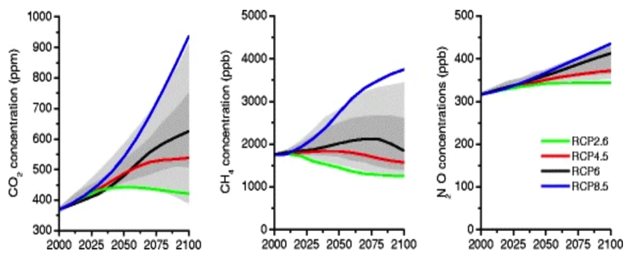
RCP concentration ranges for 3 GHGs
Source: Figure 9 in https://doi.org/10.1007/s10584-011-0148-z

Slide 37
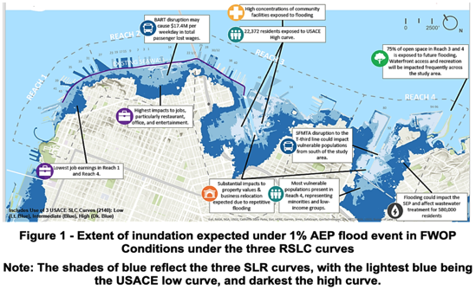
SLR example of how iterative risk management can work
San Francisco
Source: https://www.swt.usace.army.mil/Portals/41/SFWCFS_DIFR_EIS_Main%20Report_1.pdf

Slide 38
San Francisco planning description

Slide 39
SLR alternative scenarios: 1.5’, 3.5’ & 7’ by 2090

Slide 40
Iterative risk management results

Slide 41
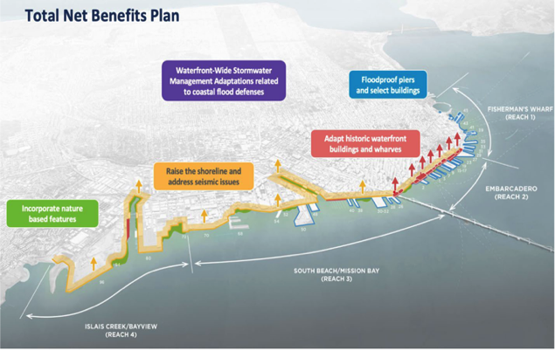
The chosen adaptation plans for 4 SF reaches

